Slide 1
Your Browser Is Your SDK!
DEV 176
Dan Silivestru, Fil Maj, Gord Tanner, Michael Brooks
May 2, 2012

Slide 2
Michael Brooks
@mwbrooks
Adobe
Gord Tanner
@gordtanner
RIM
Dan Silivestru
@confusement
RIM
Fil Maj
@filmaj
Adobe

Slide 3
w00t apps!
Target OS | Development OS | Language
RIM BlackBerry | Windows, OS X | HTML, CSS and JS. Also: Java
Apple iOS | Apple OS X | Objective C
Google Android | * | Java (Apache Harmony-ish Dalik Interpretor)
Windows Phone | Windows | Any .NET citizen (Silverlight runtime)
Samsung Bada | Windows | C++
HP webOS | * | HTML, CSS and JS (Also: NodeJS!)
Symbian, MeeGo | * | C++ (Qt)

Slide 6
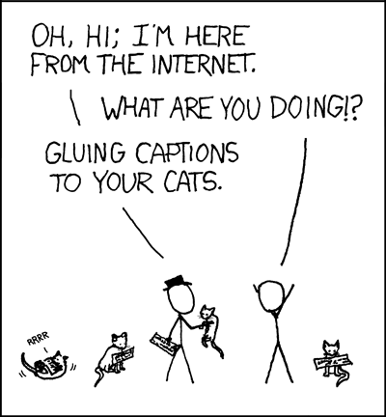
Making Progress

Slide 7
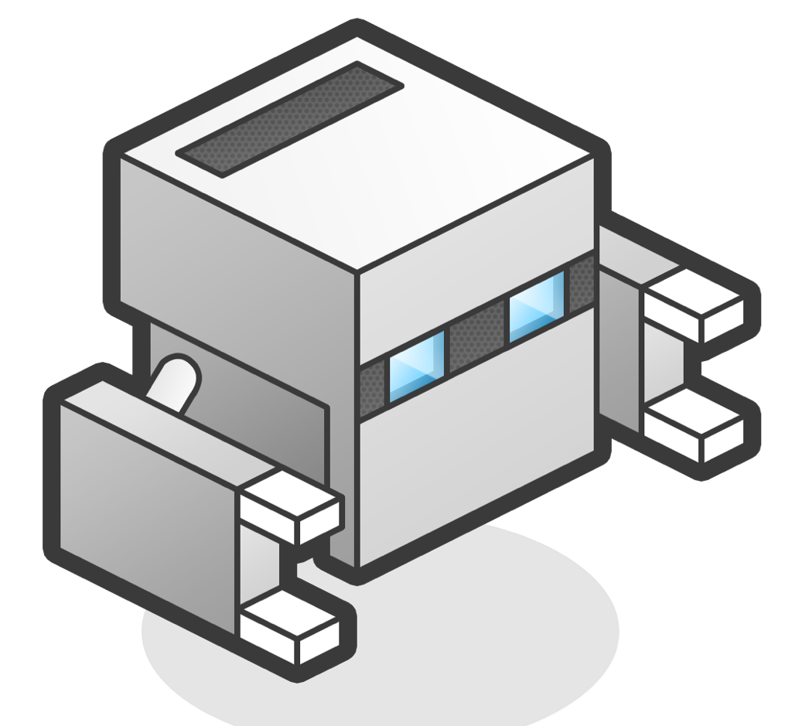
write
test
build

Slide 8
IDE
http://c9.io

Slide 9
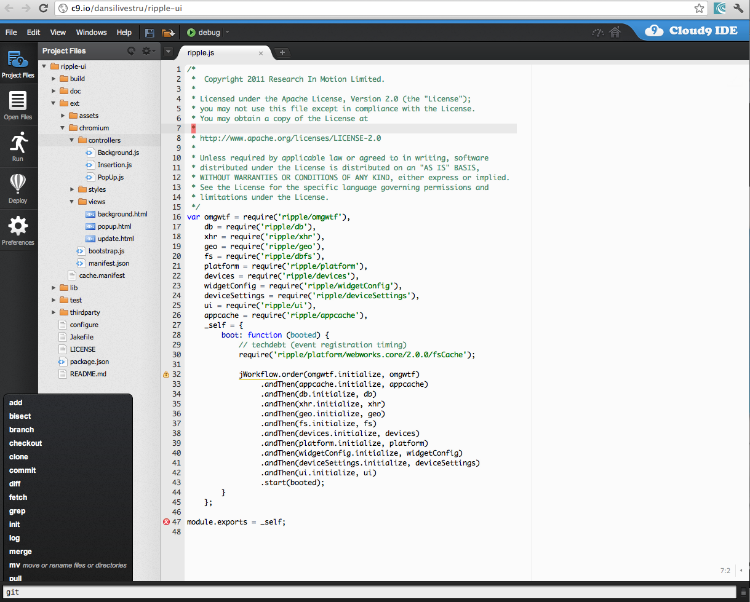

Slide 10
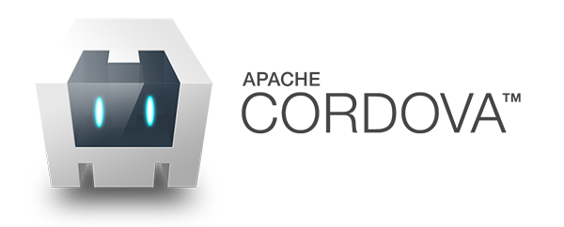
Cordova (PhoneGap)

Slide 11
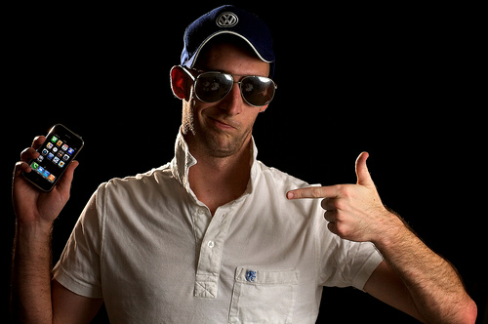
NINJA ROCKSTAR
MOBILE PROGRAMMER
GURU BRO
ONLY BUILDS FOR IOS

Slide 12
What is Cordova

Slide 13
How does it work?
Native App
Using a full screen Web Browser
No. Black. Magic.

Slide 14
How is Cordova different?

Slide 15
Ripple

Slide 16
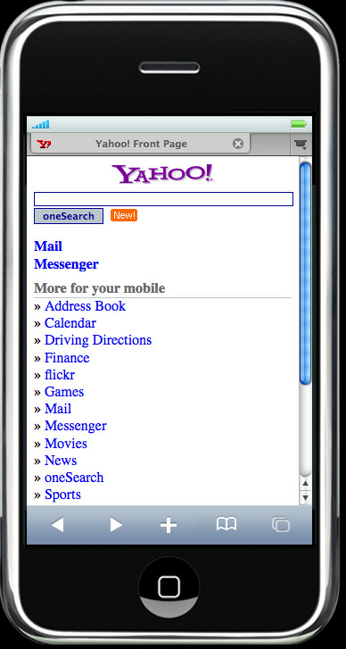
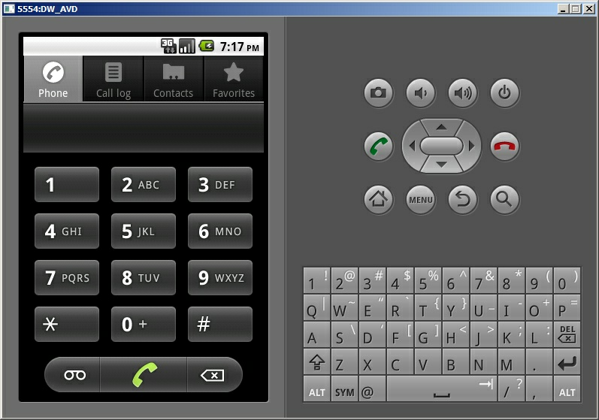
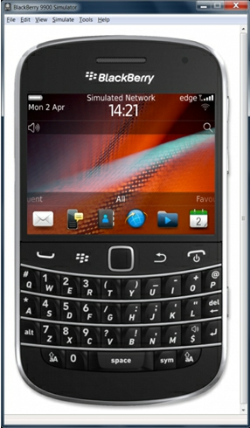
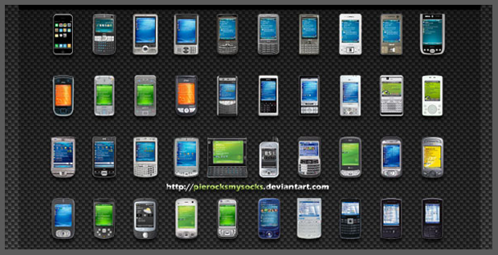
Emulators!!!
Devices!!!

Slide 18
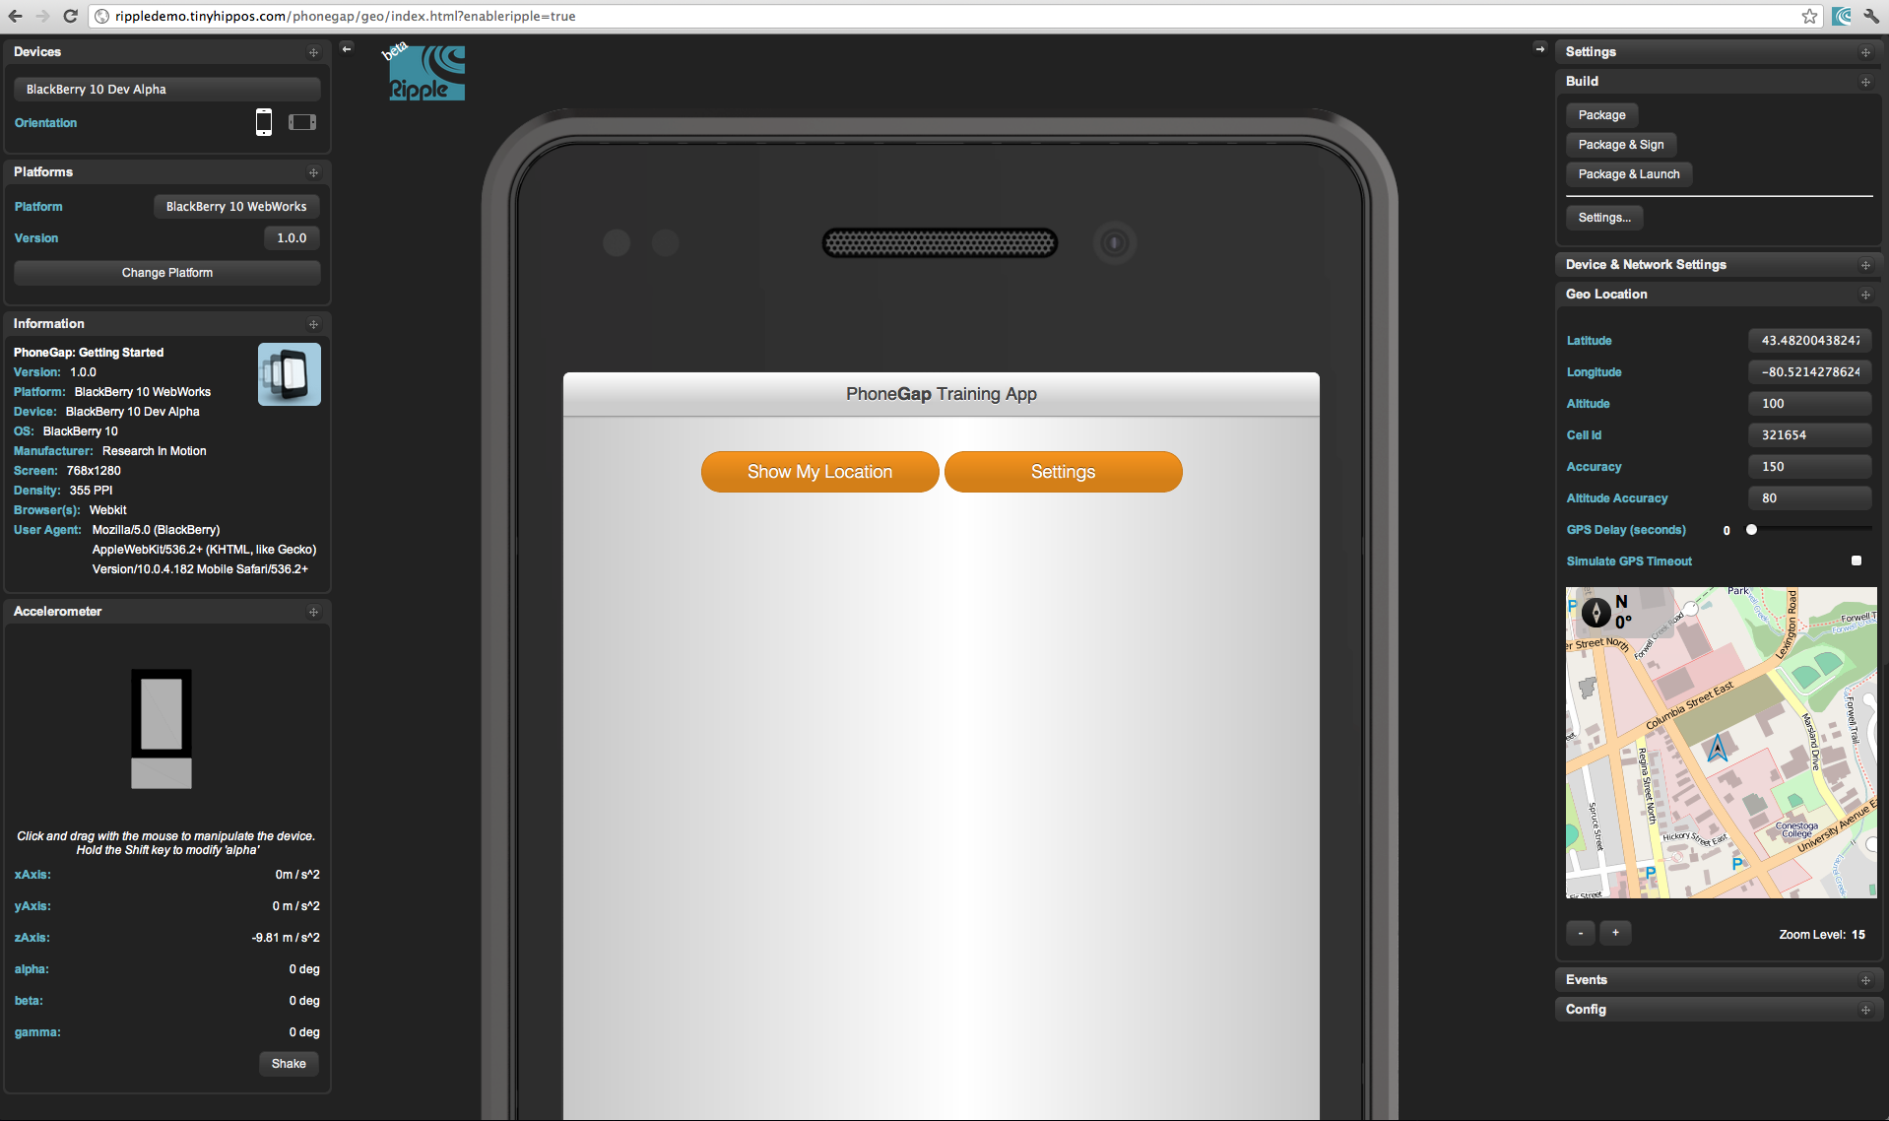

Slide 19
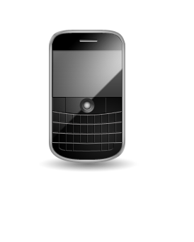
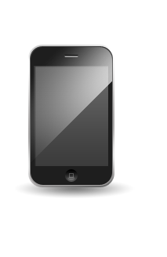
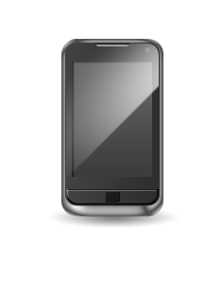
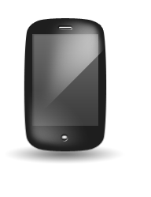
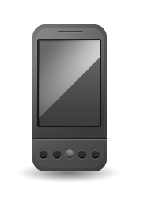
How do we test?
on

Slide 20
PhoneGap Build

Slide 21
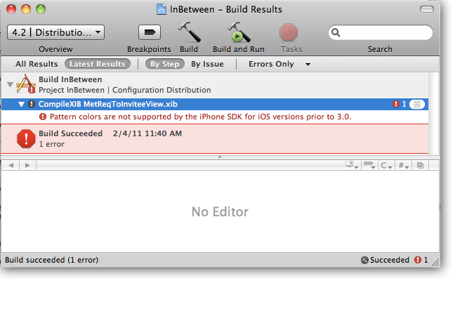
Compiling is a pain!

Slide 22
F***ing awesome!

Slide 23
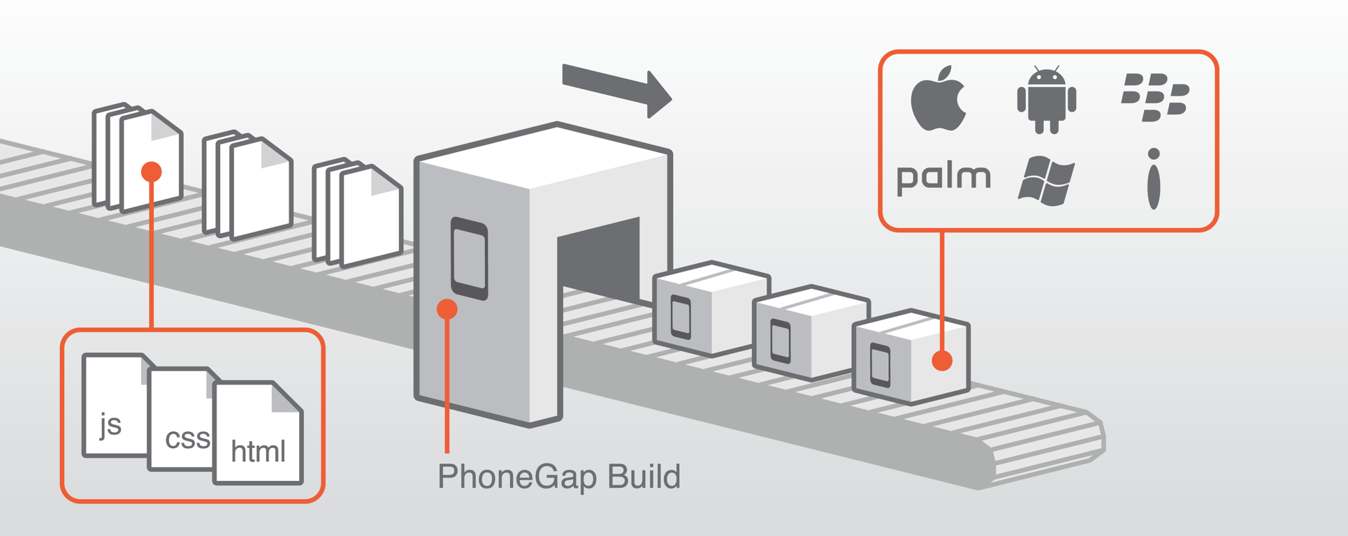
Let us worry about the SDKs

Slide 24
Talk is cheap, show me code!

Slide 25
For More Information…
https://github.com/dansilivestru/DevConShake-Client
https://github.com/dansilivestru/DevConShake-Server
http://c9.io
http://cordova.io
http://developer.blackberry.com/html5
http://ripple.tinyhippos.com (dev channel)
http://github.com/blackberry/Ripple-UI

Slide 26
THANK YOU
DEV 176
@confusement @filmaj @gordtanner @mwbrooks
May 2, 2012

